Slide 1





PRESENTATION 2026
[Retail Sale Performance Analysis For Business Decision Making]
Mentor Name
Student Name
Student Email
Ms. Umamaheshwari
Rakshita Srivastava
rakshitasrivastava450@gmail.com

Slide 2

Outline
Abstract of the Project
Problem Statement
Proposed Solution
System Architecture
Live Demo of the Project
Embedded Video of Project
Conclusion
Future Scope

Slide 3
Abstract
This project presents a detailed analysis of an online retail sales dataset to extract meaningful business insights and support business decision-making.
The main objective of the project is to identify sales trends, evaluate product performance, and analyze regional sales contribution.
The expected outcomes include a cleaned dataset, identification of key sales patterns, and an interactive dashboard showing sales performance and trends.
A key highlight of this project is the integration of Excel and Power BI along with AI tools to transform raw data into clear, visual, and actionable insights

Slide 4

Problem Statement
Retail businesses generate large volumes of raw transactional data which is difficult to interpret and analyze.
This problem is significant because without proper analysis, businesses cannot identify sales trends, product demand, or regional performance.
Retail companies and business decision-makers are directly affected as they rely on data for planning and strategy.
Existing tools like Excel are often underutilized due to lack of analytical knowledge and structured approach.

Slide 5

Proposed Solution
The proposed solution involves a structured data analytics approach to transform raw retail data into meaningful insights. The dataset is first cleaned using Microsoft Excel by removing duplicates, handling missing values, and correcting formatting issues. After preprocessing, the data is analyzed using pivot tables and Excel functions to identify trends in sales, product performance, and regional contribution. The cleaned dataset is then imported into Power BI to create interactive visualizations and dashboards. AI tools such as ChatGPT are used to assist in documentation and insight generation. This approach provides a simple yet effective solution for improving business decision-making.

Slide 6
System Architecture
Data Input / Source
Processing / Analysis
The project uses an online retail dataset sourced from Kaggle in CSV format. It contains transaction details such as invoice number, stock code, product description, quantity, invoice date, unit price, customer ID, and country
Data cleaning is performed using Microsoft Excel by removing duplicate records, handling missing values, and standardizing formats. Additional columns such as total transaction value, transaction type, etc. are created . The data was further analyzed through Power BI.
AI / Tool Integration
Output / Dashboard
Microsoft Excel is used for data cleaning and analysis, while Power BI is used for visualization and dashboard creation. ChatGPT is integrated to assist in generating explanations, insights, and project documentation.
The final output is an interactive Power BI dashboard that includes visualizations such as sales by region, top-selling products, sales trends over time, and price vs quantity relationship. It also includes slicers for dynamic filtering based on country and date.

Slide 7
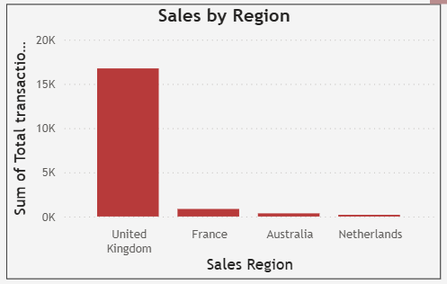
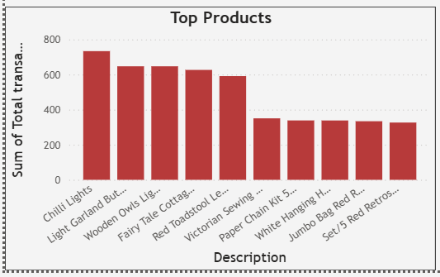
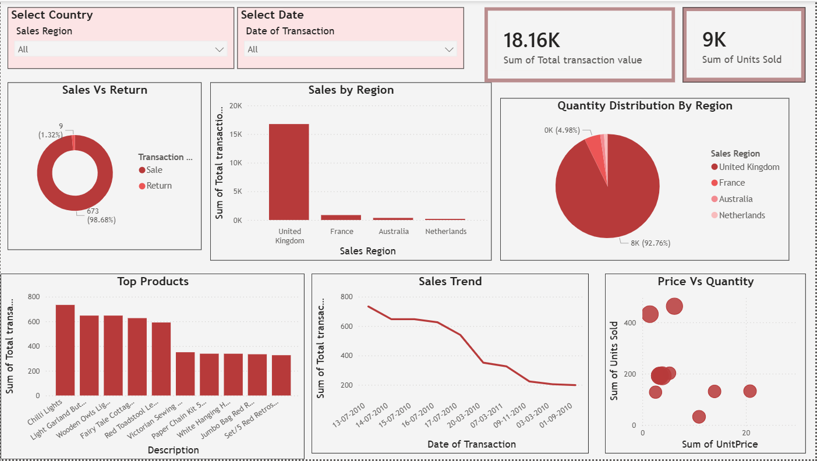
Live Demo of Project
Here's the list of some demo screenshots / features of the project:
Demo 1
Demo 2
Demo 3
This demo shows the regional sales performance, highlighting that the United Kingdom contributes the highest revenue among all countries.
This demo displays the top-selling products based on units sold, helping identify high-demand products and their contribution to overall sales
This demo presents the complete Power BI dashboard, including multiple visualizations such as sales trends,price vs quantity relationship for better business insights

Slide 8
Video of Project Demo
https://drive.google.com/file/d/1MMOPuVDT3CBnkT3lGQKKGFmFTHUMPEep/view?usp=sharing
▶
[Insert your project demo video.
You can embed a video your live project.]

Slide 9

Conclusion
The project successfully analyzed the online retail dataset and generated meaningful business insights. Key findings include the identification of top-performing products, regional sales contribution, and sales trends over time. The integration of Excel for data cleaning and Power BI for visualization helped transform raw data into a clear and structured dashboard. The objectives of the project were achieved, and the results demonstrate the importance of data analytics in supporting effective business decision-making.
CONCLUSION

Slide 10

Future Scope
The project can be further enhanced by integrating advanced tools such as machine learning models for predicting future sales trends and customer behavior. Real-time data integration can be added to improve the accuracy and timeliness of insights. Additional features such as customer segmentation and profit analysis can be included for deeper business understanding. The dashboard can also be expanded with more interactive features and larger datasets to improve scalability and usability.

Slide 11
Thank You
AICW Fellowship | Student Project Presentation 2026
LinkedIn | Edunet Foundation

